Slide 1
AGENDA SIC Round table in TAIWAN 1st
Saturday, January 7th , 2017

Slide 2
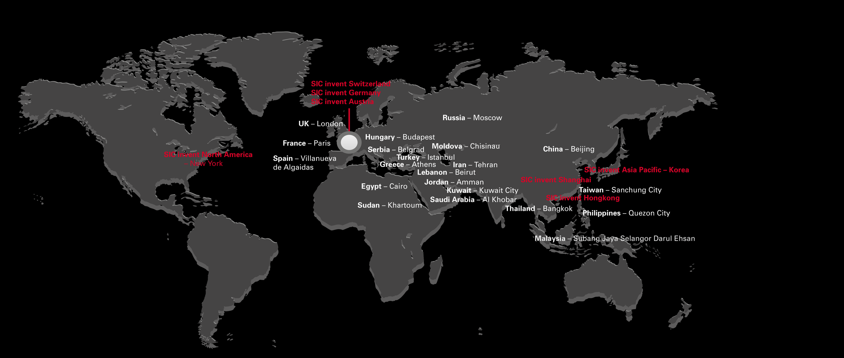
ＳＩＣ in the world
SIC invent

Slide 3
Introduction
Sic implant system 在台灣即將要進入第8年了，感謝所有醫師的支持，
sic invent 和合皓服份有限公司也在此引進與瑞士、德國同步的教育課程 round table, 建立平台讓台灣醫師與國際課程同步，除學術上交流外，更希望讓使用者加入sic members加入sic group 這個大家庭
2017 我們將替各位引進各種課程
SIC Education courses
SIC invent Human Cadaver Course in Vienna
Sic invent round table in the world
SIC Symposium in the world
International dental exhibition IDS EAO
Implantology Congress
Animations and clinical videos on YouTube and www.my-sic.com
Safe on 4 operation of the patient in China
For more information, please contact SIC

Slide 4
Sic member
Structure
First Step “Fellow”
The first step in becoming an SIC member is to become a “Fellow”. Fellows can be nominated by SIC Members or Industrial Partners. The fellowship application can be completed online, just click on Sign up. You may remain an SIC “fellow” as long as you continue to remain active within the SIC community. i.e. participating in SIC educational courses or symposia (at least one event every two year) or promoting the development of the SIC community by the publication of SIC related scientific investigations, lecturing at local, regional or international meetings on SIC related topics or contributing to the SIC community development via the portal.
線上註冊
成為研習員
保持活動狀態
至少一年
被邀請或由
SIC會員提名
在SIC會員會上
SIC Member
Requirement:
Expert SIC invent system user
Good English Language skills
National and international recognition
Must remain clinically active (must maintain clinical activity using the latest SIC products)
Must join one Members Meeting every 3 years
Must be willing to share expertise and knowledge with other SIC members
At least 5 years in practice
由主席提交給sic國際委員會投票
候選人由分會主席聯繫，並邀請加入年度大會
在會員年會上舉行頒獎儀式
成為成員

Slide 5
SIC invent
Schilli Implantology Circle: “The Think Tank“
University and scientific background
National and international exchange of knowledge and visions
Training and development of colleagues worldwide
Respecting & cultivating of individuality
Determination of patient and healthcare needs
Establishing & strengthening of networks and friendships
Notes:
DACH oben
China, Hungary, France… alphabetisch
Europe (oben), Asia-Pacific, Europe, Middle East, USA

Slide 6
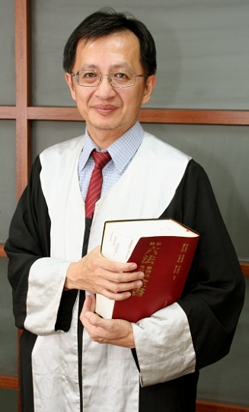
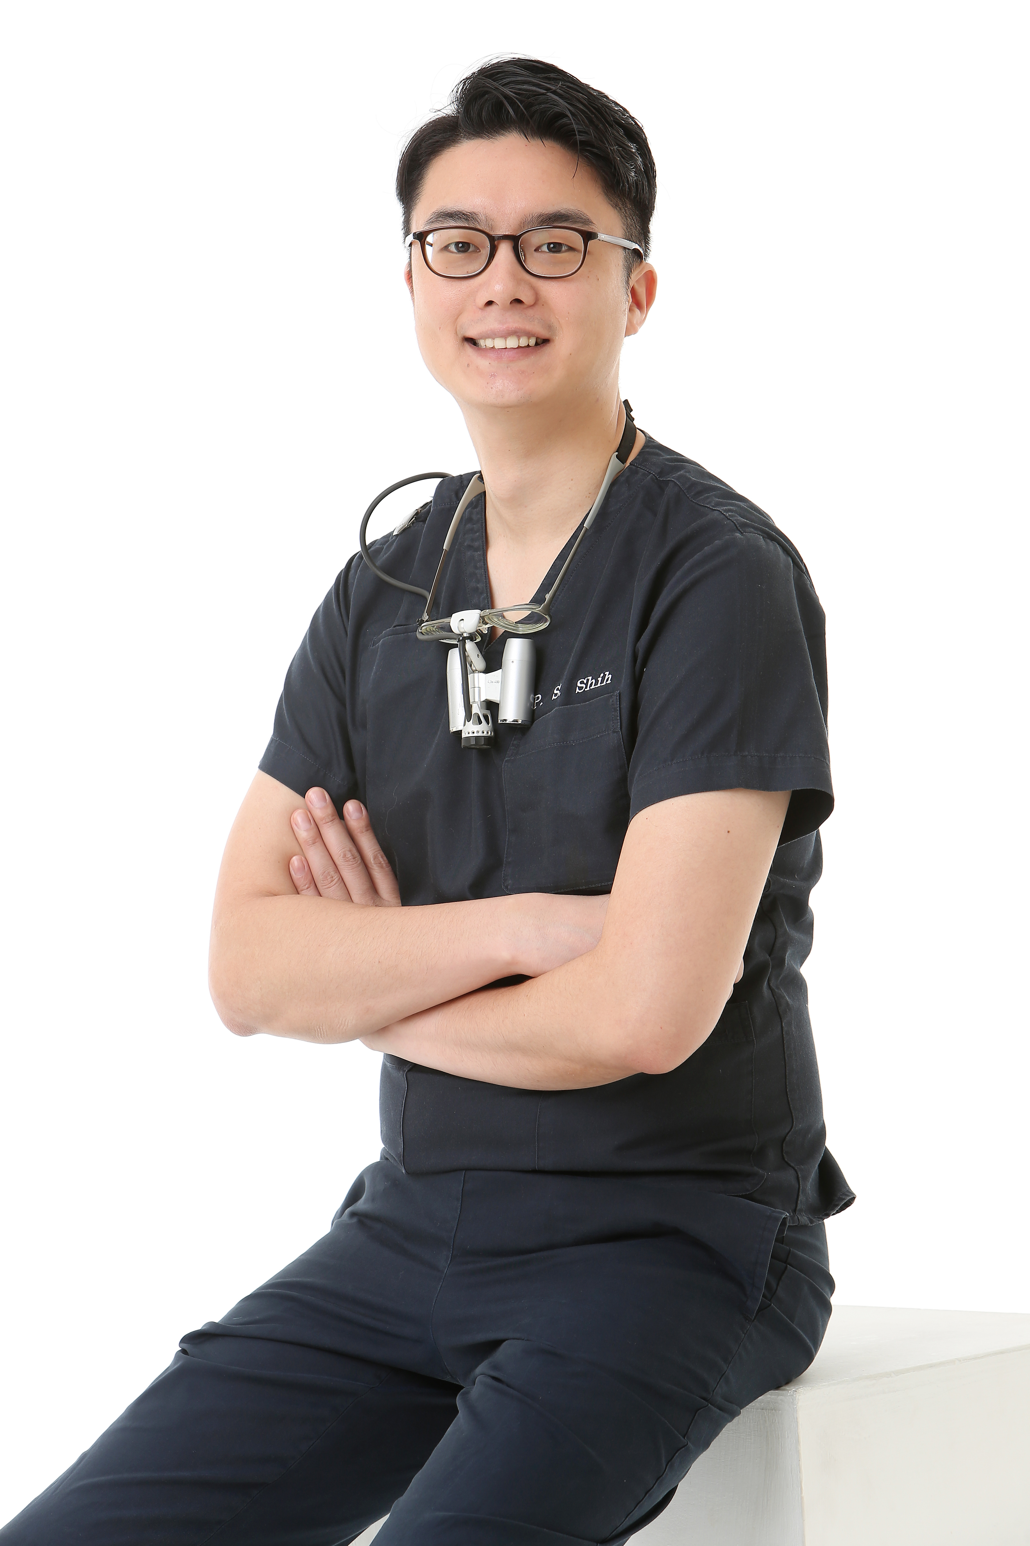
speaker
_____________________________________________________________________________
蕭世光 律師
台北醫學大學牙醫學士（第廿一屆）
國立台灣大學法律學士
民國86年律師特考及格
台北市牙醫師公會顧問律師
承展法律事務所律師
施柏聖 醫師
台北醫學大學牙醫系
中華審美牙醫學會
中華民國口腔植體學會 學術委員
IPPI牙周植牙再教育中心 培訓講師

Slide 7
schedule
Saturday, January 7th , 2017
___________________________________________________________________________
07:00 pm check in
07:10 pm sic round table Introduction Product Manager Zimmermann
＿＿＿＿＿＿＿＿＿＿＿＿＿＿＿＿＿＿＿＿＿＿＿＿＿＿＿＿＿＿＿＿＿＿＿＿＿
07:30 pm 醫糾案例系例---如何避免醫療糾紛 律師 蕭世光
＿＿＿＿＿＿＿＿＿＿＿＿＿＿＿＿＿＿＿＿＿＿＿＿＿＿＿＿＿＿＿＿＿＿＿＿＿
08:30 pm Break time
＿＿＿＿＿＿＿＿＿＿＿＿＿＿＿＿＿＿＿＿＿＿＿＿＿＿＿＿＿＿＿＿＿＿＿＿＿
08:50 pm Immediate loading in esthetic zone 醫師 施柏聖
＿＿＿＿＿＿＿＿＿＿＿＿＿＿＿＿＿＿＿＿＿＿＿＿＿＿＿＿＿＿＿＿＿＿＿＿＿
09:50 pm Ｑ＆Ａ

Slide 8
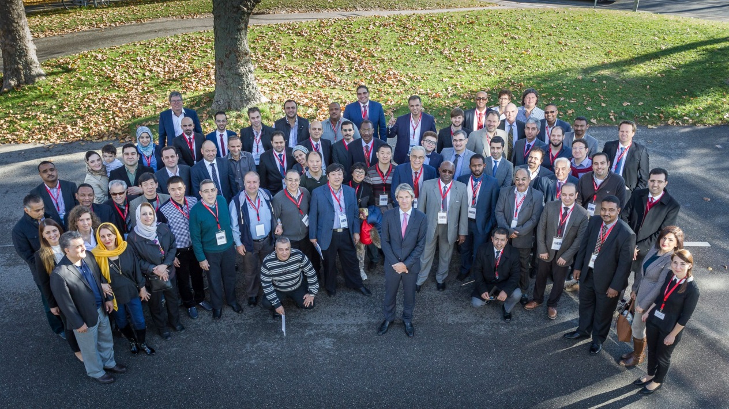
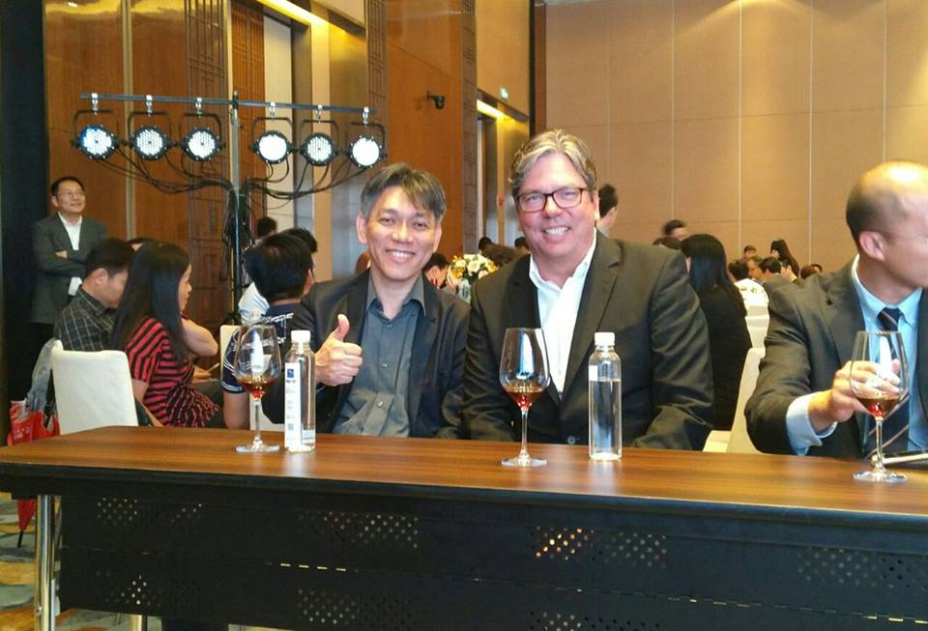
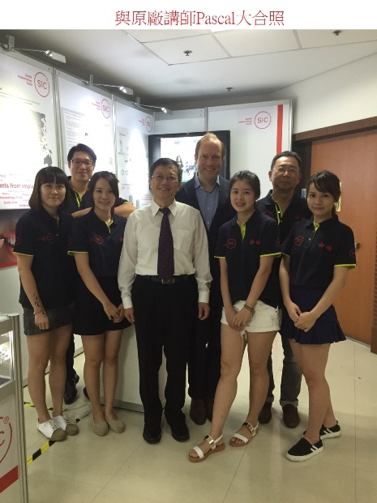
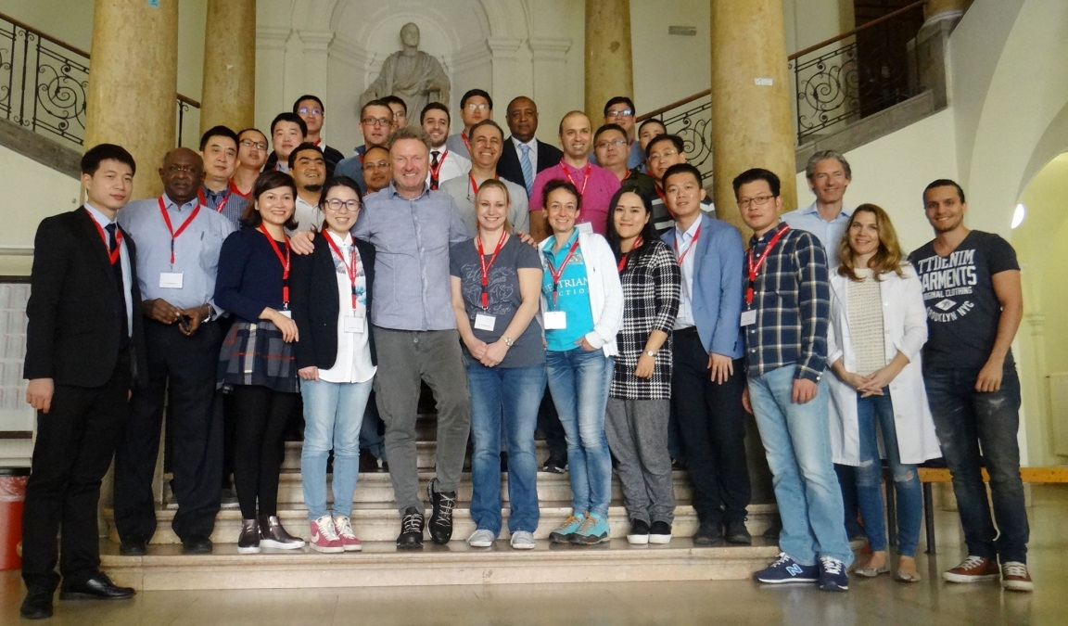
日期:2017/1/7 (六) 時間:19:00~2200 地點:福華文教會館 202 教室 (台北市新生南路三段30號) 備有地下停車場 報名方式:請洽各區 sic專員 或 來電 (02) 8972-6576 sic部門 洪小姐 活動當天晚間有提供小點心給醫師享用
SIC invent 、合皓股份有限公司 歡迎您

